Slide 1
Grade 8 Civics Field Test Administration
The Office of Student Assessment Services March 21, 2024

Slide 2
Presenters
Shannon Cullen, MCAS Test Administration Coordinator
Ann Marie Gleeson, History and Social Science Test Development Coordinator
Robert Pelychaty, Manager of Inclusive Assessment
David Ragsdale, Test Security Specialist
Holly Woodruff, Pearson Program Manager

Slide 3
Logistics for This Session
Use the Q&A feature to ask a question.
We will answer some questions aloud at specified times during this training session, and we will email the Q&A afterwards.
Type your questions anytime, but we may not answer them in real time as some questions may be covered during the presentation.
Use the thumbs-up icon to “upvote” someone else’s question.
Email student-specific questions to mcas@mass.gov instead of asking here.
This session is being recorded and will be available in about a week in the MCAS Resource Center, along with the slides.
Slides were also emailed out beforehand, and are being posted in the chat.
Closed captioning has been enabled for participants who need it.

Slide 4
Slides for This Session
Slides were emailed to participants before this session from MCASEvents@cognia.org.
Slides are now being posted in the chat.
If you cannot access the slides in the chat, ask in the Q&A.
After the session, we will send the slides again to participants, and they will be posted in the MCAS Resource Center along with the recording.

Slide 5
Today’s Agenda
Civics Field Test Overview
Civics Field Test SR/PNP
Civics End-of-Course (EOC) Field Test Administration
Civics Field Test Accommodations
Resources, Support, and Next Steps

Slide 6
1. Civics Field Test Overview

Slide 7
Resources
DESE webpage for Spring 2024 MCAS Grade 8 Civics Field Test
Resources including the list of topic assignments, participation guidance, and a sample letter to parents/guardians in English and Spanish
Manuals for the Civics Field Test
Note: Paper copies of manuals are not being produced for the Civics Field Test.
Recordings of previous virtual trainings:
Informational Session on the Spring 2024 MCAS Civics Field Test – September 26, 2023
MCAS Grade 8 Civics Virtual Informational and Training Session – November 9, 2023

Slide 8
2024 Civics Field Test Design
Grade 8 Civics Field Test in Spring 2024
State-Level Performance Task
(covers one of the seven civics topics
in the Framework)
End-of-Course Test
(covers full breadth of
grade 8 civics standards)
Selected-response and constructed-response questions Administered on TestNav
Selected-response questions only Administered on TestNav

Slide 9
2024 Field Test: State-Level Performance Tasks
Each student will take one state-level performance task.
Estimated 45–50 minutes to complete a task
Each task is based on one civics topic and consists of:
an initial 1-point selected-response question
three sets of questions
a final 4-point constructed-response question
Question sets are based around sources and consist of:
two 1-point selected-response questions
one 1-point constructed response question
List of topic assignments
Optional local-level classroom performance tasks are available to help students prepare for the state-level performance task

Slide 10
2024 Field Test: End-of-Course Test
37 test questions
Machine-scored/selected-response
Many questions based on a text source or graphic
Estimated 50–60 minutes to complete
DESE expects to release a subset of questions that will be common for all students, along with school, district, and state data (means) for those items
Student-level data will not be provided.

Slide 11
Field Test Schedule for Spring 2024
April 29–June 7, 2024: Administration window
Each student that participates will take both a state-level performance task and the EOC test.
Each component may be administered at any time during the window; they do not have to be administered on consecutive days.
The state-level performance task and EOC may be administered on the same day.
The state-level performance task should be administered before the EOC test.

Slide 12
Additional Scheduling Considerations
Students should be tested as closely together as possible, but it is not necessary to test all students concurrently.
Students may be tested during their regular Civics classes (even if those classes are at different times of the school day or on different days).
Although the field test is untimed, schools are not required to give students unlimited time during the school day to complete the test as they are with other MCAS tests.
Schools may use their discretion and ask students to submit their answers if the time they are spending on the assessment exceeds the time the school has allotted for testing.
Students who are absent on the day of testing are not required to participate in the field test when they return to school; scheduling make-up testing is at the discretion of the principal.

Slide 13
Field Test Participation
All schools with 10 or more students enrolled in grade 8 are expected to test at least 50% of their grade 8 students.
The following students are exempt from participation, though schools may count these students as part of the 50% tester threshold:
Students who need a paper-based, Braille, screen reader, or large-print edition of the test
First-year EL students (enrolled after the March 2023 SIMS submission)
Students with disabilities who take the MCAS Alternate Assessment (MCAS-Alt)

Slide 14
Field Test Participation
Schools should use their best judgment to reach the minimum requirement of 50%. For example:
Schools with an even number of grade 8 civics classes can test half of them.
Schools with an odd number of grade 8 civics classes can test half of them, plus one additional class (i.e., a school that has 7 classes should test 4 out of the 7).
Schools with one grade 8 civics class can test half the students in the class.
Classrooms should be randomly selected for participation.
The same students must participate in both the performance task and end-of-course test.

Slide 15
Field Test Platforms and Technology
Students will use TestNav for both the Performance Task and the End-of-Course test.
Schools will register students and manage testing using PearsonAccess Next.
Use the administration titled Spring 2024 MCAS Grade 8 Civics Field Test
There is no Infrastructure Trial window for the 2024 Civics field test.
Test administrators who wish to practice PAN tasks in the training site may use the spring 2024 grades 3–8 administration.
All technology requirements remain the same as for the spring grades 3–8 administration.

Slide 16
2. Civics Field Test SR/PNP

Slide 17
What is the SR/PNP?
Student Registration/Personal Needs Profile (SR/PNP) is a collection of student-level data, including
student demographic data
test registration information
information on selected accommodations that a student will use during testing
The SR/PNP determines initial test orders and provides a record of students tested and the accommodations they used.
Resources for the SR/PNP Process:
Guide to the SR/PNP Process
SR/PNP Module
Overview of the SR/PNP Process training from January 18, 2024
Supplement to the SR/PNP for the 2024 Civics Field Test (to be posted to the MCAS Resource Center soon)

Slide 18
Overview of Steps to Complete the SR/PNP Process (March 25–April 5)
DESE will prepare a .CSV file that includes all grade 8 students in your school and place it in Dropbox Central in the DESE Security Portal on March 25.
Download the .CSV file.
Delete students from the file who are no longer enrolled in your school, and add rows for students who were not included in the file and will be testing.
Verify and update students’ accessibility features and accommodations.
The .CSV file will be pre-populated with accommodations from spring 2024 grade 8 math.
Save as a .CSV file and import file into PAN.
Resolve any errors that occur.
Update student information as needed, through file export/import process or through the user interface.
Note that these are the same steps that are followed for other MCAS administrations.

Slide 19
Civics SR/PNP
All grade 8 students will be listed in the .CSV file from DESE twice:
One row for the performance task (test code CIVPER)
One row for the end-of-course test (test code CIVEOC)
Test codes will be pre-populated by DESE.
Recommendation: Schools keep all students in the .CSV file and import the file to PAN.
This means that students who are not participating will also be imported into PAN.

Slide 20
How will we differentiate participating vs. non-participating students in PAN?
As with other administrations, it is recommended to keep column M (PAN Session Name) blank during the initial import. DESE recommends assigning PAN Sessions approximately two weeks prior to testing.
Only students who are participating in the Civics field test should be assigned to PAN Sessions.
Students who are not participating in the field test do not need to be deleted from PAN.
Note: Schools may choose to remove students who will not participate in the field test from the SR/PNP file that is uploaded to PAN, but DESE recommends leaving all grade 8 students in the file to reduce the administrative burden on schools.

Slide 21
Poll Question
Which procedure for the SR/PNP do you anticipate your school using for the grade 8 Civics field test?
Leave all students in the initial SR/PNP file, and only assign participating students to PAN Sessions
Remove students who are not participating from the SR/PNP file before importing into PAN
I’m not sure yet.

Slide 22
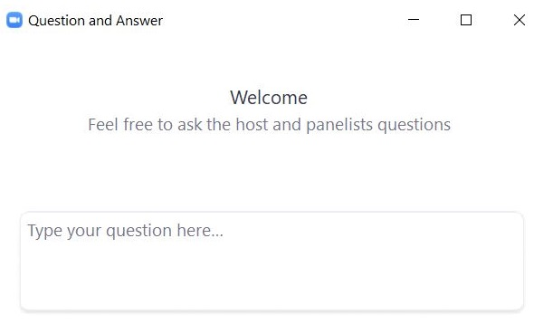
Questions and Answers
Use the “Q&A” feature to ask questions.

Slide 23
3. Civics End-of-Course (EOC) Field Test Administration

Slide 24
Civics End-of-Course Field Test
The end-of-course field test will have two “mini-sessions” that will be completed on the same day, one right after the other (scheduling options shown on upcoming slides).
The two “mini-sessions” total 37 questions and are expected to take 50–60 total minutes to complete.
They are shown in PAN and TestNav as two separate test sessions.

Slide 25
EOC Field Test Schedule Option 1
Option 1: Establish a set time to begin mini-session 2 for the whole class.
All students progress to mini-session 2 at the same time.
Test administrator reads the script for mini-session 2 to the whole class and unlocks mini-session 2 for whole class at once.
Sample EOC field test schedule:
9:00 a.m.
Test administrator reads script for mini-session 1.
Class begins mini-session 1 together.
9:30 a.m.
Students submit their answers for mini-session 1.
Test administrator locks mini-session 1 and unlocks mini-session 2.
Test administrator reads the script for mini-session 2.
Class begins mini-session 2 together.

Slide 26
EOC Field Test Schedule Option 2
Option 2: As students individually finish mini-session 1, they begin mini-session 2.
As students finish mini-session 1 and submit their answers, the test administrator will individually lock mini-session 1 and unlock mini-session 2 for each student and quietly read the script for mini-session 2 to each student.
Sample EOC field test schedule:
9:00–10:00 a.m.
Test administrator reads script for mini-session 1.
Class begins mini-session 1 together.
Individually, students finish mini-session 1.
As students finish mini-session 1 and submit their answers, the test administrator locks mini-session 1 for them and unlocks mini-session 2. Test administrator reads the script for mini-session 2 to individual students.

Slide 27
Poll Question
Which of the two options do you think you will use at your school?
Option 1: Establish a set time to begin mini-session 2 for the whole class.
Option 2: As students individually finish mini-session 1, they begin mini-session 2.
We will leave it up to test administrators to decide.

Slide 28
Questions and Answers
Use the “Q&A” feature to ask questions.

Slide 29
4. Civics Field Test Accommodations: Text-to-Speech, Speech-to-Text, and Word Prediction

Slide 30
Text-to-Speech, Speech-to-Text and Word Prediction on the 2024 Civics Field Test
Text-to-speech, speech-to-text, and word prediction will be available on the Civics field test to students who have those accommodations in their IEPs or 504 plans.
SR/PNP process for assigning these accommodations:
Text-to-speech: same for Civics as other administrations
Speech-to-text and word prediction: slightly different from other administrations
The student experience using these three accommodations is similar to other administrations.
Differences are shown on upcoming slides.

Slide 31
Registering Students for Accommodations on the 2024 Civics Field Test
In all other administrations, Web Extensions column (AQ) needs to be selected on the SR/PNP for students using speech-to-text or word prediction. This is not the case for Civics.
Column (AQ) will be replaced with “Blank” for the Civics administration.
Do not use column AQ for the Civics field test; PearsonAccess Next will return an error.
Columns AC, AI and AN will operate independently and provide students with each accessibility feature separately.
Enter a “Y” in cell rows AC, AI, and/or AN to enable each feature.

Slide 32
Registering Students for Accommodations on the 2024 Civics Field Test
If a student requires text-to-speech: Place a “Y” in column AC.
If a student requires speech-to-text: Place a “Y” in column AI.
If a student requires word prediction: Place a “Y” in column AN.

Slide 33
Verifying Accommodations on the Civics Field Test
Schools should verify accommodations approximately two weeks prior to testing using the PNP report in PAN. Note that the steps below are the same as is used in all other MCAS administrations.
Go to Reports > Operational Reports.
Check the box for Students & Registrations and select PNP Report – Accessibility Features and Accommodations for Student Tests.
This report can be filtered by either choosing all Accessibility Features and Accommodations or by choosing a specific one. The PNP Report can also be filtered by a specific organization within the district and/or by a specific test.
(See the sample PNP Report at www.doe.mass.edu/mcas/testadmin/forms.)

Slide 34
Verifying Accommodations on the Students in Sessions Page
New for Civics 2024: Text-to-speech will be indicated on the Students in Sessions page by the WebX indicator.
This means that the following three accommodations all have the same indicator:
Text-to-Speech
Speech-to-Text
Word Prediction
Schools should use the Students in Sessions page to verify that students with one of these accommodations have been assigned an accommodated form. However, the PNP report should be used to verify which accommodated form each student is assigned to.

Slide 35
Step-by-Step Procedures to Update Accommodations in PAN
Follow the same procedures that are followed in other MCAS administrations:
From the Setup drop-down, select Students.
Search by last name or SASID.
Click the checkbox next to the student’s name.
From the Select Tasks drop-down, select Manage Student Tests. Click Start. Click the content area test on the left side.
Add or remove the check from the box next to each accommodation as needed.
Click Save.

Slide 36
What if a student starts testing with the incorrect accessibility feature/accommodation?
New for Civics 2024: All accommodations can be updated after a student has signed in to the test.
Student should sign out of the test in TestNav, and the principal/test coordinator should follow the same steps listed on the previous slide.
Go to Setup > Students > Select Student > Select Tasks > Manage Student Tests > Start
Update feature or Accommodation > Save
Student signs back in to test

Slide 37
Read&Write Toolbar
In other MCAS administrations, when students are assigned speech-to-text or word prediction, they are offered the choice of using the Read&Write toolbar or the Co:Writer toolbar web extensions.
Co:Writer web extensions are not available on the Civics field test.
Students with speech-to-text or word prediction accommodations will be assigned the Read&Write toolbar web extension.
Students with text-to-speech will also use the Read&Write toolbar. Note: This is different from other test administrations.

Slide 38
Demonstrations
Text-to-speech
Speech-to-text and word prediction
Civics accommodations in the PAN User Interface

Slide 39
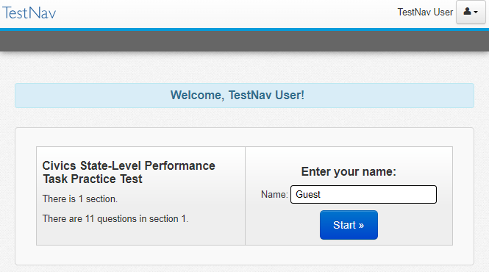
Text-to-Speech on the 2024 Civics Field Test
Text-to-Speech toolbar
When text-to-speech is selected in the SR/PNP, students will see the toolbar on the left.
This toolbar functions similarly to the text-to-speech toolbar on other MCAS tests.
It reads aloud text on the screen and alternative text for images.
It highlights text word-by-word as it reads aloud text on the screen.
Students may control the speed of the read aloud.
Key differences:
Jump back and skip ahead buttons are not available
Does not read text within drag-and-drop graphics.

Slide 40
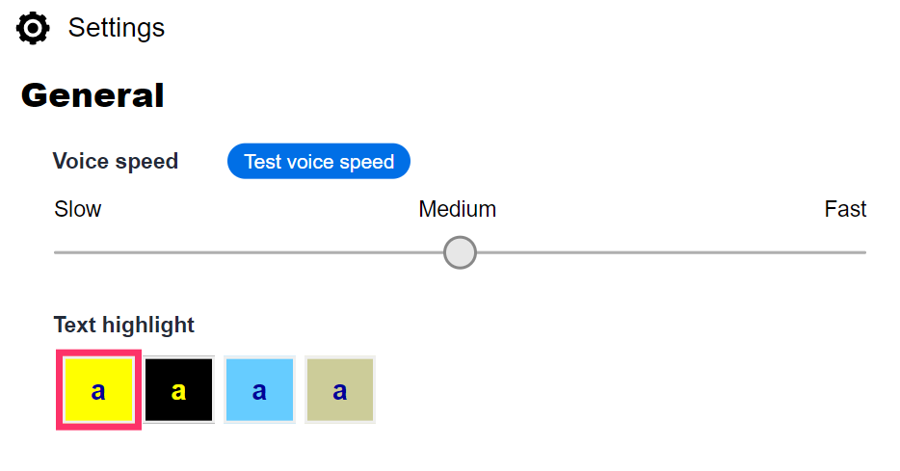
Text-to-Speech on the 2024 Civics Field Test
Button | Feature
 | Select the Directional button to drag the toolbar to a new location on the screen.
 | Select the Click to Speak button to select the text or question where the read aloud will begin.
 | Select the Play button to start the read aloud.
 | Select the Pause button to pause the read aloud.
 | Select the Stop button to stop the read aloud.
 | Select the Settings button to choose how fast the text is read and which text highlight color you prefer to use.

Slide 41
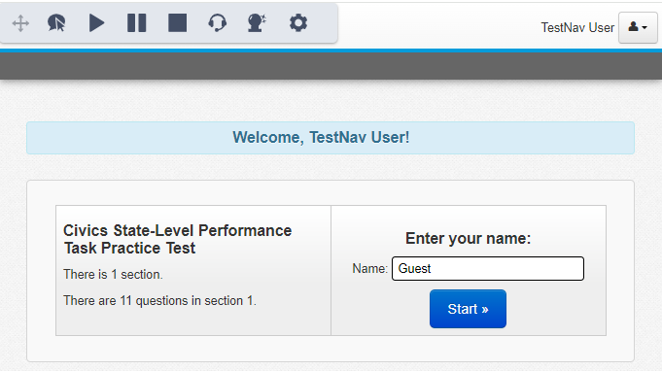
Web Extensions on the 2024 Civics Field Test
The web extension toolbar for speech-to-text and word prediction is the same as on other MCAS tests.
Buttons (from left to right):
Enable speech-to-text
Enable word prediction

Slide 42
Text-to-Speech and Web Extensions on the 2024 Civics Field Test
Students using all three accommodations (text-to-speech, speech-to-text, and word prediction) will see the enlarged toolbar on the left.

Slide 43
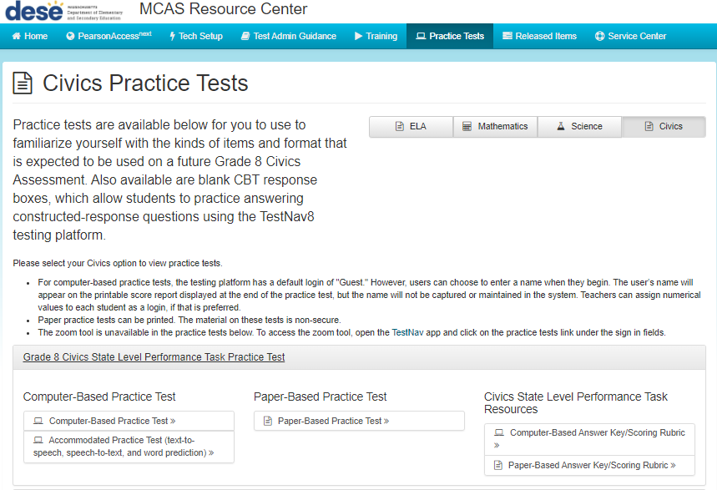
Accommodations on the 2024 Civics Field Test
The Performance Task and End-of-Course practice tests are available on the MCAS Resource Center.
Students who will be using these accommodations on the field test should practice with the accommodated practice tests.

Slide 44
Questions and Answers
Use the “Q&A” feature to ask questions.

Slide 45
5. Resources, Support, and Next Steps

Slide 46
Additional Resources
Resource | Location
Guide to the SR/PNP Process | mcas.pearsonsupport.com/manuals (“PearsonAccess Next Guidance” drop-down)
Enrollment Transfer Guide | mcas.pearsonsupport.com/manuals (“PearsonAccess Next Guidance” drop-down)
Online training modules and previously recorded trainings | mcas.pearsonsupport.com/training
Accessibility and accommodations guidance and link to modules and recording of a live session | mcas.pearsonsupport.com/manuals (“Accessibility and Accommodations Guidance” drop-down)

Slide 47
Civics Resources
Resource | Description
Civics Field Test Administration Resources | Resources for administering the 2024 Civics Field Test (e.g., administration manuals, test schedule, topic assignments)
Practice tests | State-level performance task and EOC test questions
Released items | Items from the 2023 Civics pilot
Grade 8 Civics Expectations and Clarification Document for Assessment | Developed by DESE’s Office of Student Assessment Services in collaboration with the Center for Instructional Support (CIS) Provides additional guidance for learning and assessment expectations of the grade 8 Civics standards
Local-level classroom performance task materials for each Civics topic | Includes performance task, teacher instructions and scoring guides, and presentation slides

Slide 48
Next Steps
Today: Complete the evaluation form.
Responses are associated with the name and email address used to log in.
Email your input to mcas@mass.gov if you have problems accessing or completing the form.
Within one week:
Receive an email with the Q&A from this session
Recording will be available

Slide 49
Email and Phone Support
MCAS Service Center
DESE Student Assessment Services
Questions on logistics and technology (e.g., PearsonAccess Next, SR/PNP, TestNav)
Web: mcas.pearsonsupport.com
Email: mcas@cognia.org
Phone: 800-737-5103
Schedule Technology Support Call.
Policy questions (e.g., student participation, accommodations, “I have a student who…”)
Web: www.doe.mass.edu/mcas
Email: mcas@mass.gov
Phone: 781-338-3625

Slide 50
THANK YOU
The Office of Student Assessment Services
781-338-3625
mcas@mass.gov
www.doe.mass.edu/mcas
135 Santilli Highway, Everett, MA 02149

